Slide 1
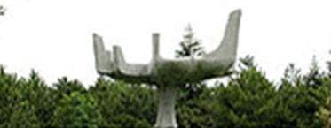
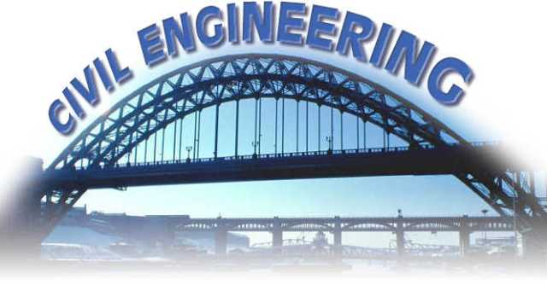
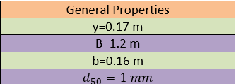
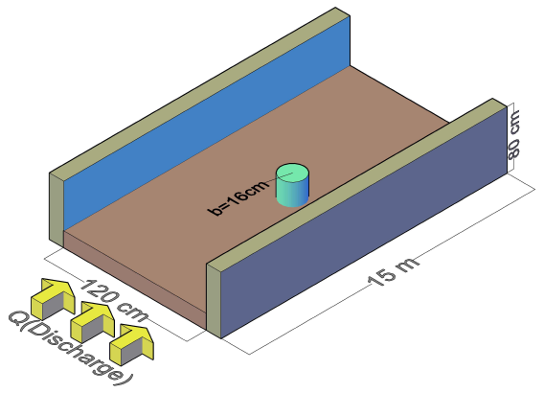
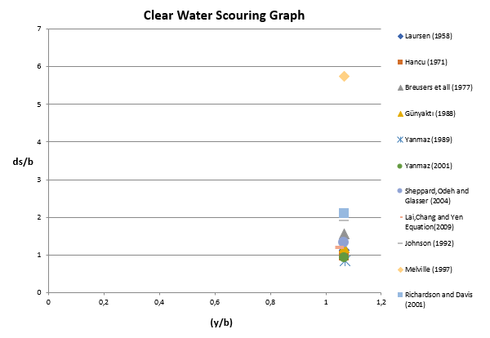
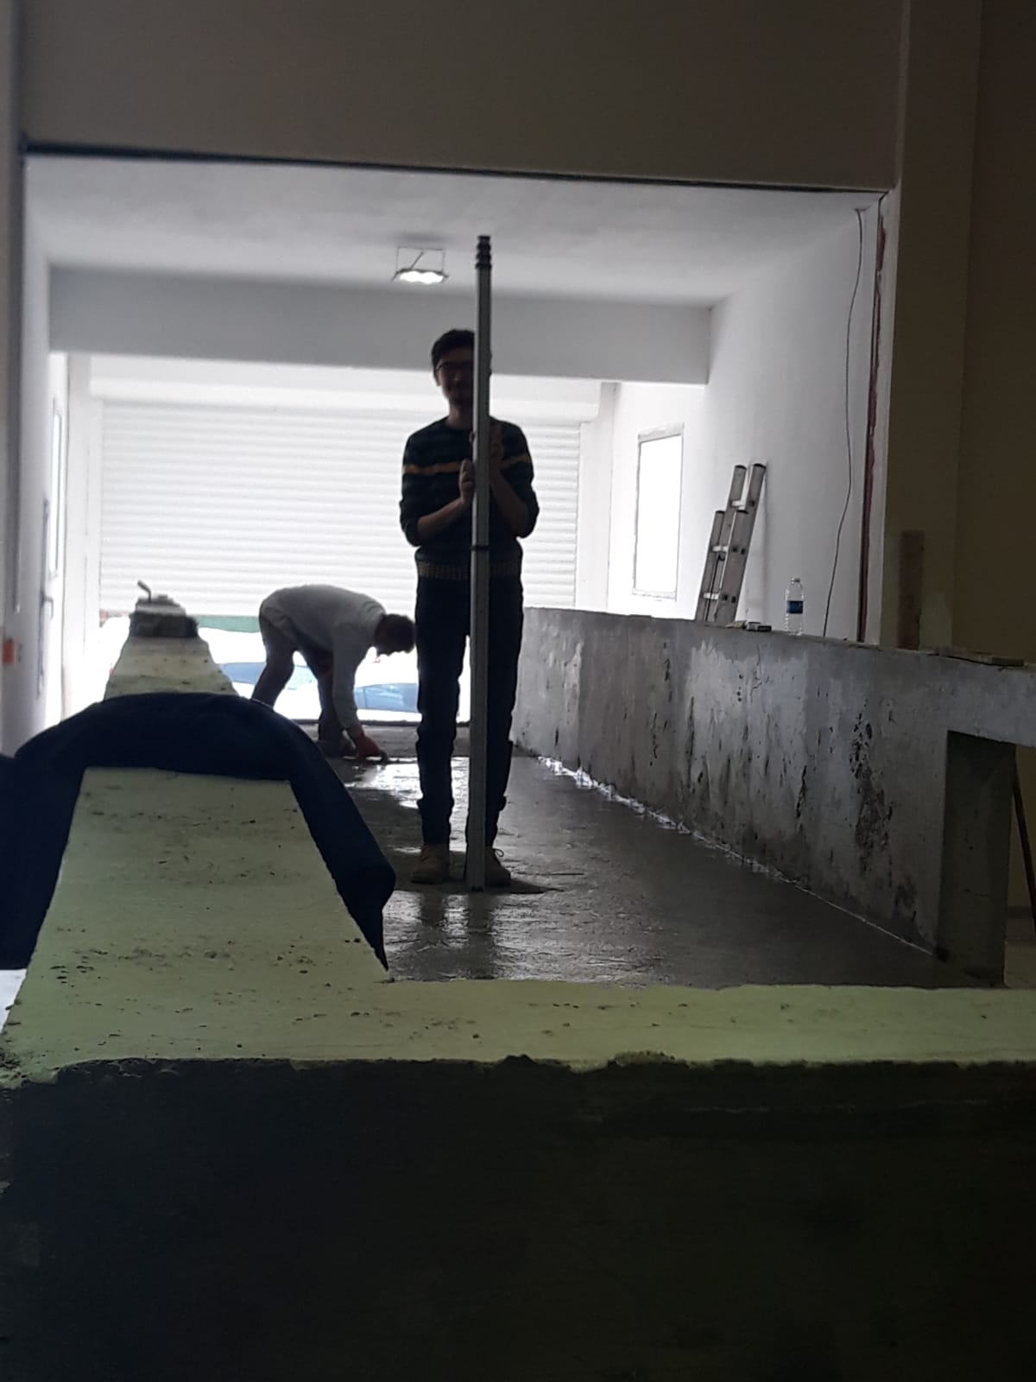
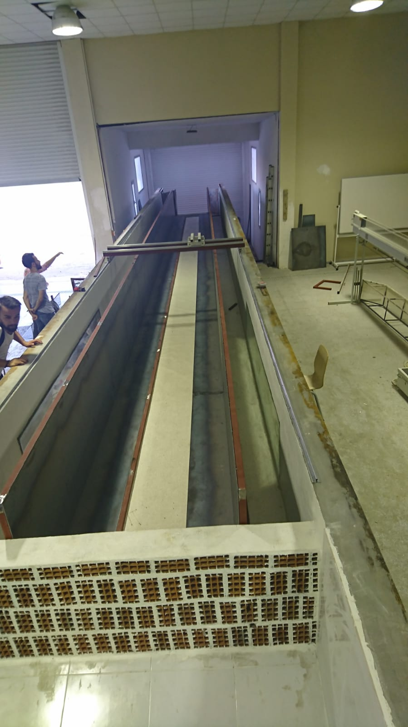
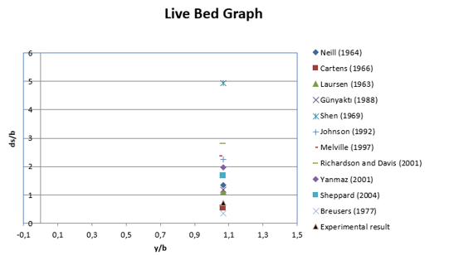
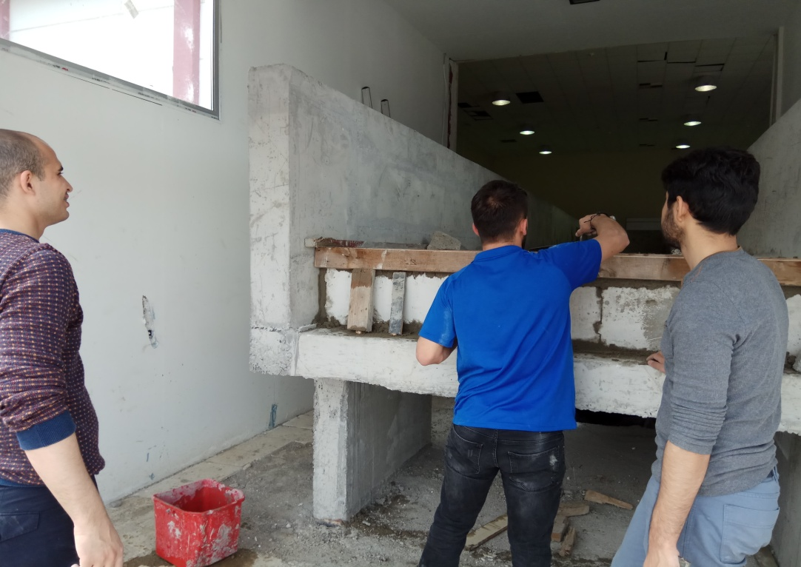
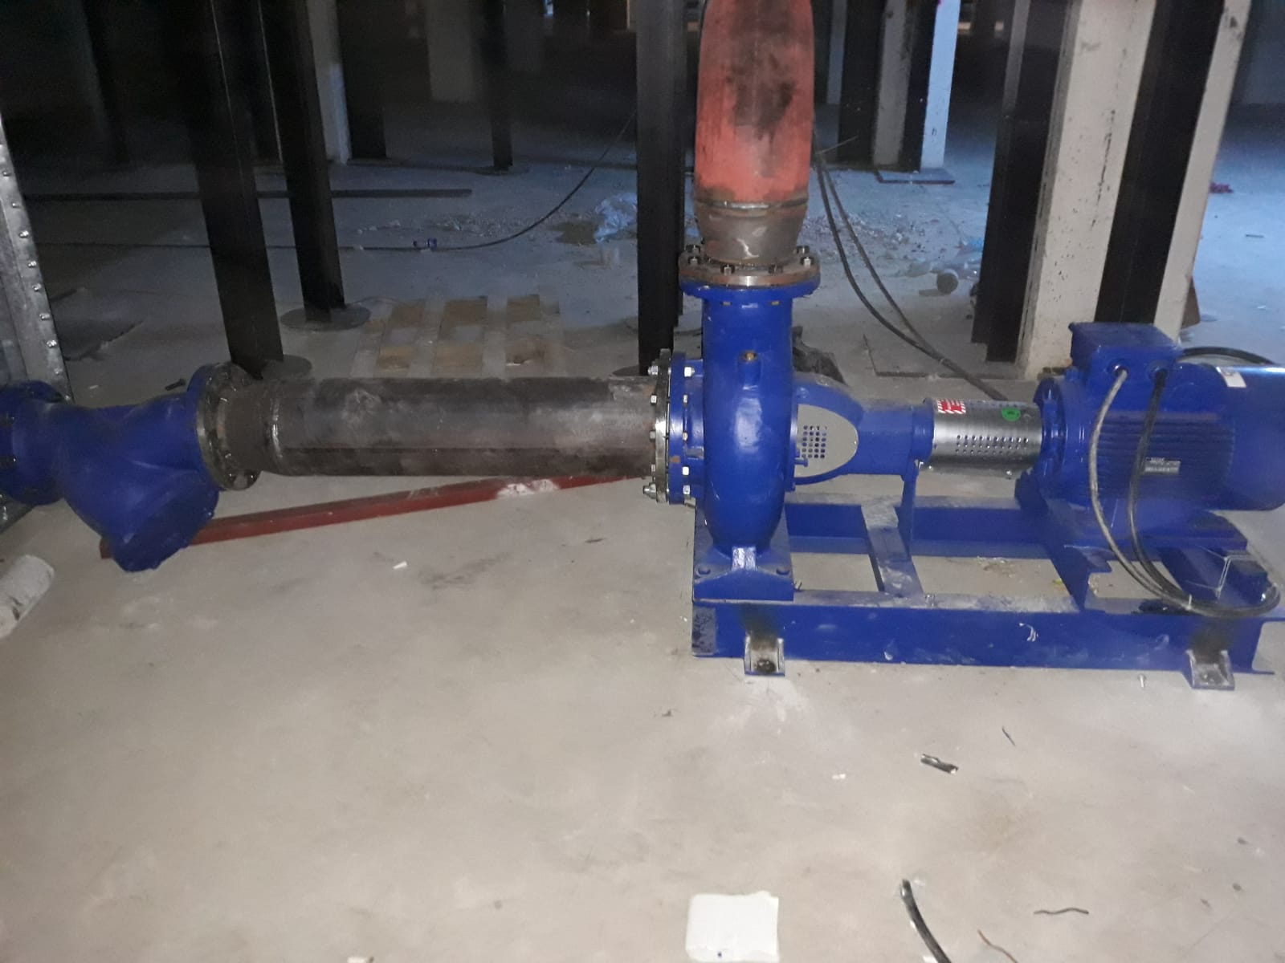
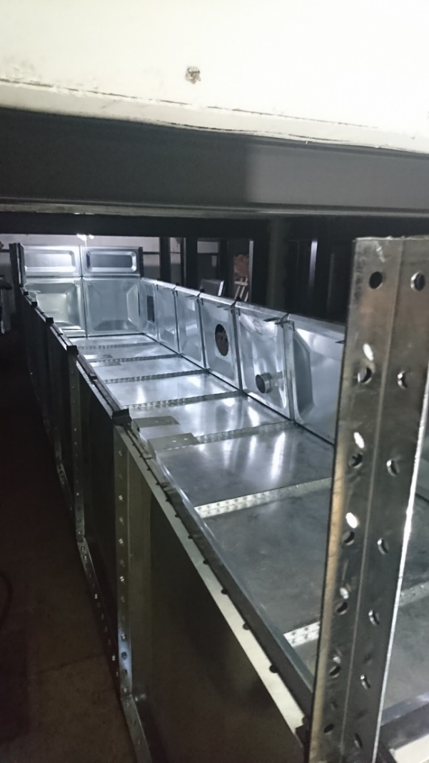
INVESTIGATION OF XXXXXXXX
Student 1 Name SURNAME
Student 2 Name SURNAME
Student 3 Name SURNAME
Student 4 Name SURNAME
Student 5 Name SURNAME
Supervisor: Dr. Name SURNAME
ABSTRACT
Maximum Scour Depth for Live Bed Condition:
Neil(1964) $\frac{d_{se}}{b}=1.35{\left(\frac{y}{b}\right)}^{0.3}$
Shen(1969)$\frac{d_{se}}{b}=3.4{F_{r}}^{\frac{2}{3}}{\left(\frac{y}{b}\right)}^{1/3}$
Breusers at al.(1977) $\frac{d_{se}}{b}=2tanh\left(\frac{y}{b}\right)$
Xxxxxxxxx xxxxx xxxxxx xxxxx xxxxx xxxxx xxxxxx xxxxx xxxxx. Xxxxxxxxx xxxxx xxxxxx xxxxx xxxxx xxxxx xxxxxx xxxxx xxxxx. Xxxxxxxxx xxxxx xxxxxx xxxxx xxxxx xxxxx xxxxxx xxxxx xxxxx. Xxxxxxxxx xxxxx xxxxxx xxxxx xxxxx xxxxx xxxxxx xxxxx xxxxx.
INTRODUCTION
Where;
$$b:Pier Width V:Approach Velocity$$
$y:Approach flow depth{ V}_{c}:Critical Velocity$ $F_{r}: Froude Number d_{50}:Median Grain Size$
$N_{s}:Number of Grain{ b}^{∗}:Effective Diameter$
Xxxxxxxxx xxxxx xxxxxx xxxxx xxxxx xxxxx xxxxxx xxxxx xxxxx. Xxxxxxxxx xxxxx xxxxxx xxxxx xxxxx xxxxx xxxxxx xxxxx xxxxx. Xxxxxxxxx xxxxx xxxxxx xxxxx xxxxx xxxxx xxxxxx xxxxx xxxxx (Deng & Cai, 2009).
Xxxxxxxxx xxxxx xxxxxx xxxxx xxxxx xxxxx xxxxxx xxxxx xxxxx. Xxxxxxxxx xxxxx xxxxxx xxxxx xxxxx xxxxx xxxxxx xxxxx xxxxx. Xxxxxxxxx xxxxx xxxxxx xxxxx xxxxx xxxxx xxxxxx xxxxx xxxxx (Deng & Cai, 2009).
Xxxxxxxxx xxxxx xxxxxx xxxxx xxxxx xxxxx xxxxxx xxxxx xxxxx. Xxxxxxxxx xxxxx xxxxxx xxxxx xxxxx xxxxx xxxxxx xxxxx xxxxx. Xxxxxxxxx xxxxx xxxxxx xxxxx xxxxx xxxxx xxxxxx xxxxx xxxxx (Deng & Cai, 2009).
Xxxxxxxxx xxxxx xxxxxx xxxxx xxxxx xxxxx xxxxxx xxxxx xxxxx. Xxxxxxxxx xxxxx xxxxxx xxxxx xxxxx xxxxx xxxxxx xxxxx xxxxx. Xxxxxxxxx xxxxx xxxxxx xxxxx xxxxx xxxxx xxxxxx xxxxx xxxxx (Deng & Cai, 2009).
Xxxxxxxxx xxxxx xxxxxx xxxxx xxxxx xxxxx xxxxxx xxxxx xxxxx. These components;
Xxxxxx,
Xxxxxx,
Xxxxxx,
Xxxxxxxxx xxxxx xxxxxx xxxxx xxxxx xxxxx xxxxxx xxxxx xxxxx. Xxxxxxxxx xxxxx xxxxxx xxxxx xxxxx xxxxx xxxxxx xxxxx xxxxx. Xxxxxxxxx xxxxx xxxxxx xxxxx xxxxx xxxxx xxxxxx xxxxx xxxxx. Xxxxxxxxx xxxxx xxxxxx xxxxx xxxxx xxxxx xxxxxx xxxxx xxxxx. Xxxxxxxxx xxxxx xxxxxx xxxxx xxxxx xxxxx xxxxxx xxxxx xxxxx.
RESULTS AND DISCUSSION
PURPOSE OF THE STUDY
Xxxxxxxxx xxxxx xxxxxx xxxxx xxxxx xxxxx xxxxxx xxxxx xxxxx. Xxxxxxxxx xxxxx xxxxxx xxxxx xxxxx xxxxx xxxxxx xxxxx xxxxx.
Xxxxxxxxx xxxxx xxxxxx xxxxx xxxxx xxxxx xxxxxx xxxxx xxxxx. Xxxxxxxxx xxxxx xxxxxx xxxxx xxxxx xxxxx xxxxxx xxxxx xxxxx. Xxxxxxxxx xxxxx xxxxxx xxxxx xxxxx xxxxx xxxxxx xxxxx xxxxx. Xxxxxxxxx xxxxx xxxxxx xxxxx xxxxx xxxxx xxxxxx xxxxx xxxxx.
EXPERIMENTAL SETUP
THEORETICAL REVIEW
Xxxxxxxxx xxxxx xxxxxx xxxxx xxxxx xxxxx xxxxxx xxxxx xxxxx. Xxxxxxxxx xxxxx xxxxxx xxxxx xxxxx xxxxx xxxxxx xxxxx xxxxx.
Time Evolution Equations:
Franzetti(1982) $\frac{d_{s}}{d_{se}} =\left(1−exp\left(−BT^{C}\right)\right)$
Where;
$$d_{s}:scour depth T:dimensionless time$$
$d_{se}:equilibrium scour depth$ $t:time$
$B and C :constant te:equilibrium time$
$F_{d}:densimetric Froude Number density$
$$_{g}:geometric Standart Deviation for sediment particles$$
$$t_{R}:reference Time$$
Maximum Scour Depth Clear Water Condition:
Hancu(1971): $\frac{d_{se}}{b}=2.42{\left(\frac{y}{b}\right)}^{1/3}{Fr}^{2/3}$
Xxxxxxxxx xxxxx xxxxxx xxxxx xxxxx xxxxx xxxxxx xxxxx xxxxx. Xxxxxxxxx xxxxx xxxxxx xxxxx xxxxx xxxxx xxxxxx xxxxx xxxxx. Xxxxxxxxx xxxxx xxxxxx xxxxx xxxxx xxxxx xxxxxx xxxxx xxxxx (Deng & Cai, 2009).
Xxxxxxxxx xxxxx xxxxxx xxxxx xxxxx xxxxx xxxxxx xxxxx xxxxx. Xxxxxxxxx xxxxx xxxxxx xxxxx xxxxx xxxxx xxxxxx xxxxx xxxxx. Xxxxxxxxx xxxxx xxxxxx xxxxx xxxxx xxxxx xxxxxx xxxxx xxxxx (Deng & Cai, 2009).
Xxxxxxxxx xxxxx xxxxxx xxxxx xxxxx xxxxx xxxxxx xxxxx xxxxx. Xxxxxxxxx xxxxx xxxxxx xxxxx xxxxx xxxxx xxxxxx xxxxx xxxxx. Xxxxxxxxx xxxxx xxxxxx xxxxx xxxxx xxxxx xxxxxx xxxxx xxxxx. Xxxxxxxxx xxxxx xxxxxx xxxxx xxxxx xxxxx xxxxxx xxxxx xxxxx. Xxxxxxxxx xxxxx xxxxxx xxxxx xxxxx xxxxx xxxxxx xxxxx xxxxx. Xxxxxxxxx xxxxx xxxxxx xxxxx xxxxx xxxxx xxxxxx xxxxx xxxxx.
Xxxxxxxxx xxxxx xxxxxx xxxxx xxxxx xxxxx xxxxxx xxxxx xxxxx.
REFERENCES
ALABI, P.D. Time development of local scour at a bridge scour fitted with a collar. Thesis presented to the University of Saskatchewan for graduate in department of civil and geological engineering,August, 2006.
RICHARDSON, E.V. and DAVIS, S.R., (2001), Evaluating Scour at Bridges, Hydraulic Engineering Circular No. 18, Fourth Edition, FHWA NHI 01-001, May 2001.
YANMAZ, A.M. (2002). Köprü Hidroliği, METU publications. Ankara,Turkey

